Slide 1
RFID Technology
February 04, 2016
By Chady DAGHER

Slide 2

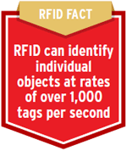
CHAPTER 01 What Is RFID?
Radio frequency identification (RFID) is a form of wireless communication that uses radio waves to identify and track objects
An RFID system has readers and tags that communicate with each other by radio.

Slide 3
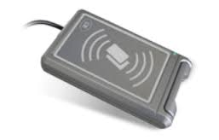
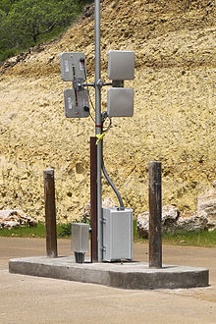
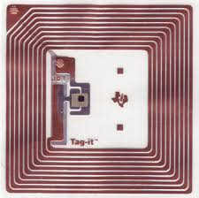
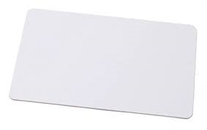
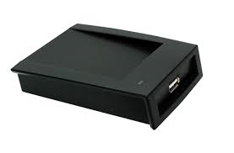
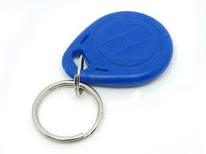
RFID Tags
RFID Readers

Slide 4
Why use RFID?
- Greatly enhance and protect the lives of
consumers.
- Use RFID if you want to wirelessly identify something
without line of sight.
- RFID can be used to track and monitor the physical
world automatically and with accuracy.

Slide 5

RFID Applications
- Automate inventory and asset-tracking in
healthcare, manufacturing, retail, and business
sectors
- Identify the source of products, enabling intelligent
recall of defective or dangerous items.

Slide 6
- Revent use of counterfeit products in the supply
chain
- Improve shopping experience for consumers,
with fewer out-of-stock items and easier returns
- Wirelessly lock, unlock and configure electronic
devices
- Enable access control of certain areas or devices
- Access management
- Tracking of goods

Slide 7
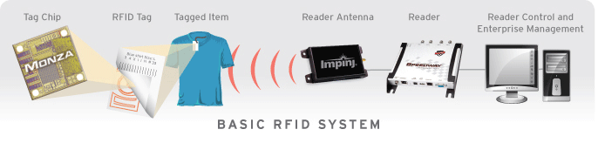
CHAPTER 02 How Do RFID Systems Work?
Tag Reader
Tag chips or integrated circuits (ICs) Reader antenna
Tag antennas Reader control & application software

Slide 8
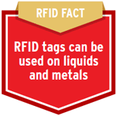

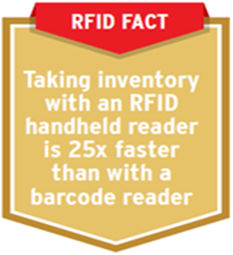
RFID Facts

Slide 9
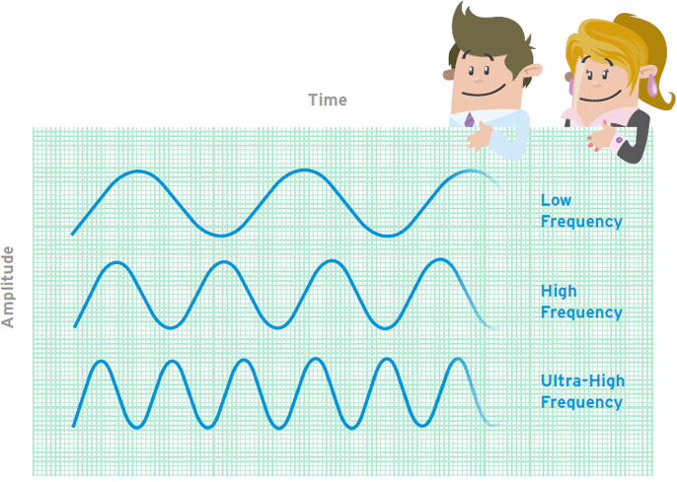
CHAPTER 03 The Different Types of RFID Systems

Slide 10
CHAPTER 04 RFID Standards
What are RFID standards?
Why are RFID standards important?
Who sets RFID ?

